Slide 1


Slide 2
OVERVIEW OF DENGUE AND ITS MANAGEMENT
Dr. AMRIT YOG DATLEY
SOURCE : WHO guidelines for diagnosis,
treatment, prevention and control

Slide 3
EPIDEMIOLOGY
Dengue is most rapidly spreading mosquito-borne viral disease.
In the last 50 yrs, incidence has increased 30 fold with an estimated 50 million dengue infections occur annually world wide.
Some 1.8 billion of the population of south-east asia region and western pacific region are at risk for dengue which bear nearly 75% of global disease burden due to dengue.

Slide 4
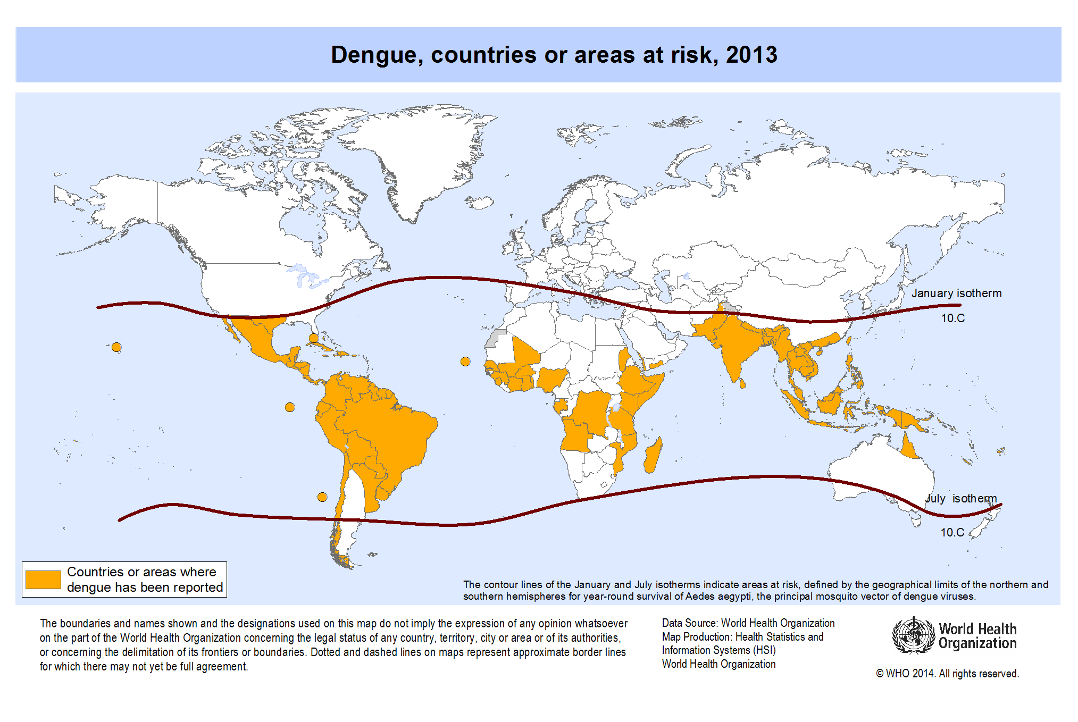

Slide 5
Reported case fatality rates for this region are approximately 1% but in India and Indonesia focal outbrakes away from urban areas have case fatality around 3-5%.
Correct pronunciation of dengue is ‟ dengi ”.

Slide 6
Dengue case classification-
- grouped into 3 categories-
1. Undifferentiated fever
2. Dengue fever (DF)
3. Dengue haemorrhagic fever (DHF)
- DHF further classified into 4 severity grades
with grade III and grade IV defined as
dengue shock syndrome (DSS).

Slide 7
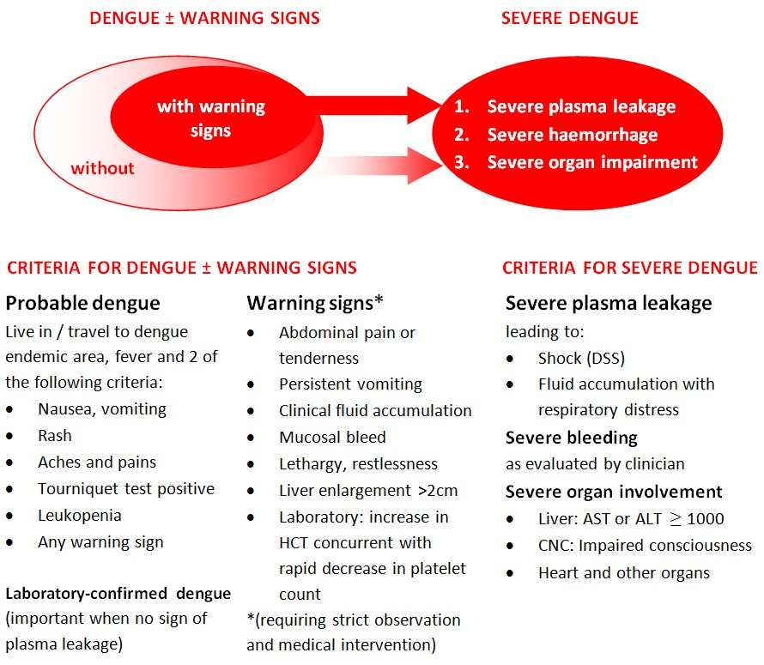

Slide 8
TRANSMISSION
Dengue virus is small single stranded RNA virus.
4 distinct serotype ( DEN 1 to DEN 4)
Transmitted to human through the bite of infected Aedes aegypti mosquito.
Incubation period is 4-10 days.
Primary infection is thought to induce life long immunity to infecting serotype.

Slide 9
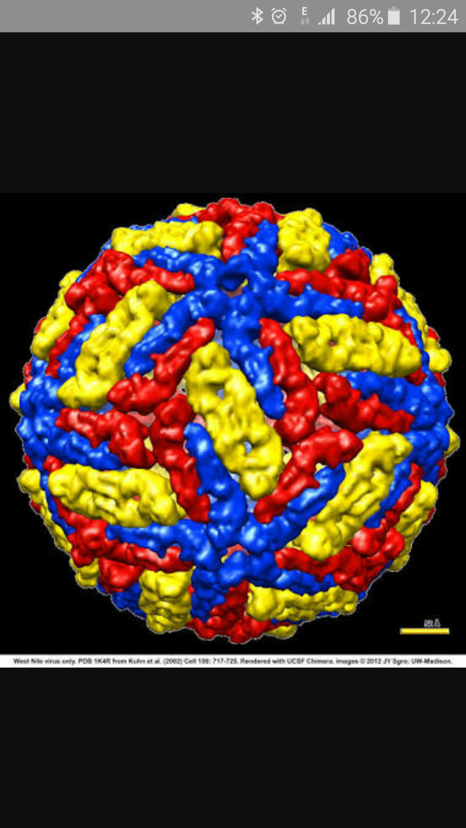

Slide 10
CLINICAL MANAGEMENT
Dengue infection has 3 phases-
1. Febrile phase
2. Critical phase
3. Recovery phase

Slide 11
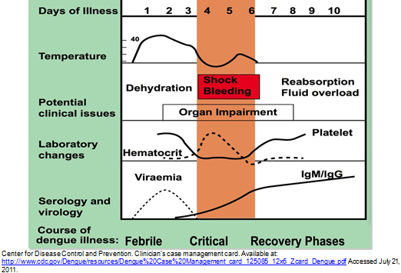

Slide 12
Febrile phase-
- Lasts 2-7 days
- Pt develop high grade fever suddenly
- Facial flushing, skin erythema
- Generalised bodyache, myalgia, arthralgia,
headache.
- Sore throat, anorexia, nausea and vomiting
- Mild haemorrhagic manifestation like
petechiae and mucosal membrane bleeding (gums and nose)

Slide 13
- Massive vaginal bleeding and gastrointestinal
bleeding may occur during this phase but is
not common.
- Liver is enlarged and tender after a few days
of fever.
- Earliest abnormality in the CBC is progressive
decrease in total WBC count ( high probability
of dengue).
- Positive torniquet test in this phase increases the
probability of dengue.( high probability of
dengue).

Slide 14
2. Critical phase-
- At the time of defervescence, when the
Temp. drops to 37.5-38⁰C or less and
remains below this level, on days 3-7 of
illness, an increase in capillary permeability
in parallel with increasing haematocrit levels
may occur.
- This marks the beginning of critical phase.
- period of clinically significant plasma leakage
lasts for 24-48 hrs.

Slide 15
- Progressive leukopenia followed by a rapid
decrease in platelet count usually precedes
plasma leakage.
- At this point pt without an increase in capillary permeability will improve while those
with increase permeability may become as a
result of lost plasma volume.
- pleural effusion and ascitis may be present.
- Degree of increase above the baseline
haematocrit reflects the severity of plasma
leakage.

Slide 16
- When a critical volume of plasma is lost then shock occurs.
- Body temperature subnormal.
- hypoperfusion results in progressive organ
impairment, metabolic acidosis and DIC.
- This leads to severe Hemorrhage causing the hematocrit to decrease in severe shock.
- instead of leukopenia usually seen during this
phase, the total WBC count may increase in pt
with severe bleeding.

Slide 17
- Severe organ impairment like severe hepatitis, encephalitis or myocarditis and/or severe bleeding may also develop without obvious plasma leakage or shock .
- Respiratory distress from massive pleural
effusion and ascites may occur at any time if
excessive fluids have been administered.

Slide 18
3. Recovery phase-
- If pt survives the 24-48 hrs of critical phase,
a gradual reabsorption of extravascular fluid
takes place in the following 48- 72 hrs.
- Generalised pruritus, bradycardia and ecg
changes are common.
- Haematocrit stabilizes or may be lower due
to dilutional effect of reabsorbed fluid.
- WBC count start to rise and recovery of
platelet is typically later than that of WBC count.

Slide 19
Severe dengue-
- defined by one or more of the following:
a. Plasma leakage that may lead to shock or
fluid accumulation, with or without
respiratory distress.
b. Severe bleeding.
c. Severe organ impairment.

Slide 20
- during the initial stage of shock there is
- Normal systolic BP,
- Tachycardia,
- Peripheral vasoconstriction with reduced
skin perfusion,
- Cold clammy extremities,
- Delayed capillary refilling time,
- Diastolic pressure rises towards systolic BP
producing narrow pulse pressure.
- Finally there is decompensation and both
pressures disappears abruptly.

Slide 21
Pt is considered to have shock if the pulse pressure is ≤ 20 mm hg or has signs of poor capillary perfusion ( cold extremities, delayed capillary refill > 3 second, or rapid pulse rate.
Pt may have coagulation abnormality but usually not sufficient to cause major bleeding.
When major bleeding occur, it is almost always associated with profound skock this, in combination with thrombocytopenia, hypoxia and acidosis can lead to multiple organ failure and DIC.

Slide 22
Massive bleeding may occur without shock when Aspirin, Ibuprofen and Steroid has taken ( contraindication).
Unusual manifestation-
Acute liver failure
Encephalopathy
Cardiomyopathy

Slide 23
Severe dengue should be considered if the pt is from an area of dengue risk with fever of
2-7 days plus any of the following:-
1. Evidence of plasma leakage
- high or progressive rising haematocrit,
- Pleural effusion or ascites,
- Circulatory compromise or shock.
2. Significant bleeding
3. Altered level of consciousness
4. Severe gastrointestinal involvement
( Persistent vomiting, increasing abd pain,
jaundice)

Slide 24
5. Severe organ impairement –
- Acute liver failure
- Acute renal failure
- Encephalopathy or encephalitis
- Cardiomyopathy

Slide 25
MANGEMENT
At primary level-
- Recognizing that the febrile pt could have
dengue.
- Notification of suspected case of dengue.
- Recognizing the early stage of plasma
leakage or critical phase and initiating fluid
- Recognition of warning sign and referral.

Slide 26
WHEN TO REFER
Early presentation with shock ( on days 2 or 3 of illness ).
Severe plasma leakage or shock
Undetectable pulse or BP
Severe bleeding
Fluid overload
Organ impairment

Slide 27
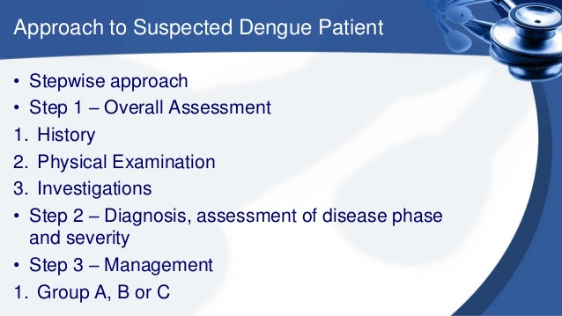

Slide 28
TREATMENT ACCORDING TO
GROUPS A-C
Group A- pt who may be sent home
- pt who are able to tolerate adequate
volume of oral fluids.
- pass urine once every six hrs.
- no warning sign, particularly when fever
subsides.
- Pt should be reviewed daily fro disease
progression ( decreasing WBC count, warning
sign, defervescence).
- Pt with stable haematocrit can be sent home.

Slide 29
Encourage fluid intake ( ORS, fruit juice and other fluids containing electrolytes and sugar).
Give paracetamol for high fever, interval should not be less than 6 hrs.
Do not give Aspirn, Ibuprofen or other NSAIDS, it may aggravate gastritis or bleeding.

Slide 30
Pt should be brought immediately to hospital if any of the following occur:
- No clinical improvement
- deterioration around the time of
defervescence,
- severe abdominal pain,
- persistent vomiting,
- cold and clammy extremities,
- lethargy or irritability/ restlessness,
- Bleeding( black stool, coffee ground vomitus
- Not passing urine for more than 4-6 hrs.

Slide 31
Group B- pt who should be referred for in- hospital management, these include-
- Pt with warning sign
- Pt with coexisting condition like( pregnancy,
infancy, old age, obesity, diabetes mellitus
renal failure, chronic hemolytic disease).
- Certain social circumstances ( such as living
alone, living far from a health facility
without reliable means of transport).

Slide 32
If the pt has dengue with warning sign, the action plan should be as follows:-
- Obtain reference haematocrit before fluid
therapy.
- Give only isotonic solutions such as 0.9%
saline, RL or hartmann’s solution.
- Start with 5-7 ml/kg/hr for 1-2 hrs, then
- reduce to 3-5 ml/kg/hr for 2-4 hrs , then
- reduce to 2-3 ml/kg/hr or less acc to clinical
response.

Slide 33
Reassess the clinical status and repeat the haematocrit.
If haematocrit remains the same or rises minimally, continue the same rate (2-3ml/kg/hr ) for another 2-4 hrs.
If vitals signs are worsening and haematocrit is rising rapidly, increase the rate to 5-7ml/kg/hr for 1-2 hrs.
Reassess the clinical status, heamatocrit and review fluid infusion rates accordingly.

Slide 34
Maintain urine output of about 0.5ml/kg/hr.
I.V. fluids are usually needed for only 24-48 hrs.
Reduce fluids gradually when the rate of plasma leakage decreases towards the end of critical phase, which is indicated by adequate urine output, oral fluid intake or haematocrit
decreasing below the baseline value in a stable pt.
Monitoring of vital signs and peripheral perfusion 1-4 hrly, urine output 4-6 hrly, haematocrit before and after fluid replacement and then 6-12 hrly.

Slide 35
Group C- pt who require emergency treatment and urgent referral when they have severe dengue, these include :-
- severe plasma leakage leading to dengue
shock and/or fluid accumulation with
respiratory distress.
- severe haemorrhage.
- severe organ impairment ( hepatic damage
renal impairment, cardiomyopathy,
encephalopathy or encephalitis).

Slide 36
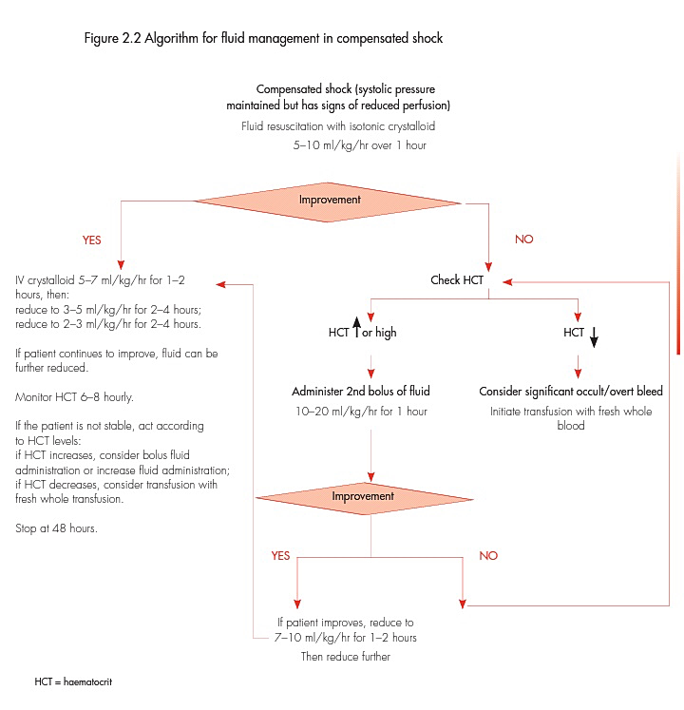

Slide 37
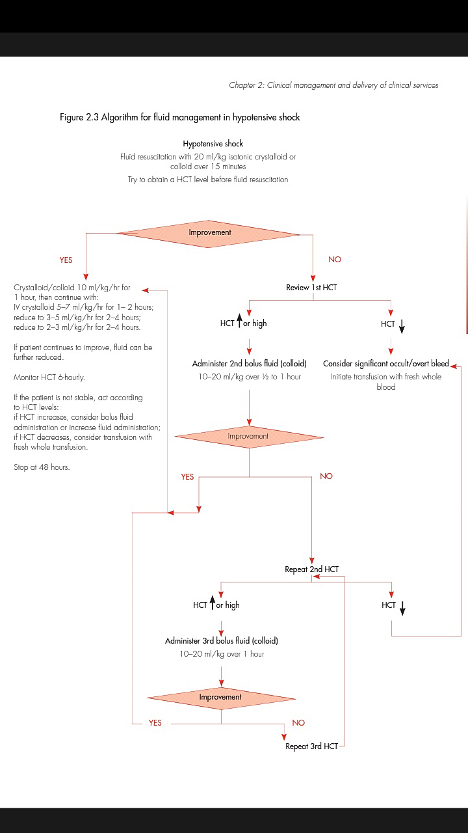

Slide 38
Treatment of heamorrhagic complication:-
- Do not give intramuscular injection to
avoid trauma.
- prophylactic platelet transfusions for
severe thrombocytopenia in otherwise
haemodynamically stable pt have not been
shown to be effective and are not
necessary.

Slide 39
Pt at risk of major bleeding-
- have prolonged and refractory shock
- have hypotensive shock, renal or liver failure
severe and persistent metabolic acidosis.
- are given NSAIDS agent.
- have pre existing peptic ulcer disease.
- are on an anticoagulant therapy.
- have any form of trauma, including i.m.
injection.

Slide 40
Severe bleeding can be recognized by-
- persistent or severe overt bleeding
- decrease in haematocrit after fluid
resuscitation with unstable hemodynamic
condition.
- refractory shock that fails to respond to
consecutive fluid resuscitation of 40-
60 ml/kg.
- persistent metabolic acidosis ± a well
maintained systolic BP, especially in those
with severe abd. tenderness and distension.

Slide 41
Treatment of hemorrhagic complication:-
- give 5-10 ml/kg of fresh packed RBCs or 10-
20 ml/kg of fresh whole blood.
- A good clinical response includes improving
haemodynamic status and acid base balance
- repeat BT if there is further blood loss or no
appropriate rise in hematocrit occur after BT
- there is little evidence to support the use of
transfusing the platelet concentrates and/or
FFP for severe bleeding, it can be practised
when bleeding can not be managed with
fresh BT or fresh packed RBCs.

Slide 42
TREATMENT OF COMPLICATION
Fluid overload-
* causes- excessive or rapid i.v. fluid
- use of hypotonic solution
- use of large volume of fluid in pt
with unrecognized bleeding
- inappropriate use of FFP, Platelet
concentrate, cryoprecipitate.
- continuation of fluid when plasma l
leakage has resolved.

Slide 43
Clinical feature of fluid overload:-
- respiratory distress, difficulty in breathing
- rapid breathing
- chest wall indrawing
- wheezing ( rather than crepitation)
- large pleural effusion/ tense ascites
- increased JVP
- pulmonary edema
- irreversible shock

Slide 44
Management:-
- O2 therapy
- stopping of i.v. fluid, when following sign
present, i.v. fluid should be discontinued
a. signs of cessation of plasma leakage
b. stable pulse, BP and peripheral perfusion
c. haematocrit decreases in presence of a
good volume pulse.
d. afebrile for more than 24-48 hrs( without
antipyretic)
e. improving urine output

Slide 45
If the pt is haemodynamically stable and is out of the critical phase ( 24-48 hrs of defervescence) stoop i.v. fluid but continue close monitoring.
If necessary, give oral or i.v. furosemide 0.1-0.5mg/kg/ dose once or twice daily or a continuous infusion of furosemide 0.1mg/kg/hr

Slide 46
Other complication-
- hyperglycemia and hypoglycemia
- electrolyte and acid base imbalance
- hyponatremia
- hypokalemia, hyperkalemia
- serum calcium imbalance
- metabolic acidosis ( sodium bicarbonate
for metabolic acidosis is not recommended
for pH ≥ 7.15).

Slide 47
Supportive care-
- renal replacement therapy with preference
to continuous veno-venous dialysis.
- vasopressor and inotropic to prevent life
threatening hypotension.
- further treatment of organ impairment like
severe hepatic involvement or
encephalopathy or cardiac abnormalities.
- no evidence in favour of use of steroid, i.v.
immunoglobulins or recombinant activated
factor VII.

Slide 48
diagnosis
Virus isolation
Nucleic acid detection
a.RT-PCR
b. Real- time RT-PCR
c. Isothermal amplification method
3. Detection of antigens
4. Serological tests
a. MAC-ELISA
b. IgG ELISA

Slide 49
c. IgM/IgG ratio
d. IgA
e. haemagglutinion- inhibition test

Slide 50
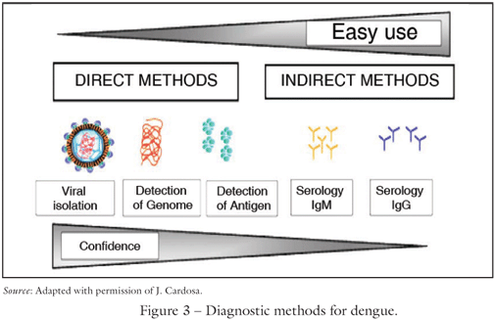

Slide 51
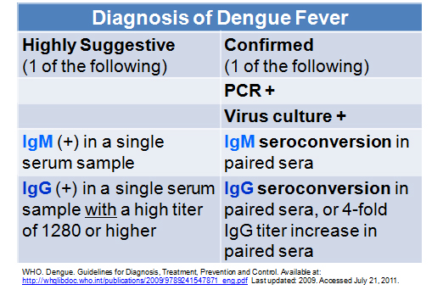

Slide 52
VACCINES
Chimeric tetravalent vaccine in which structural genes (prM and E )each of the four dengue virus were inserted to replace those of yellow fever viruses in the yellow fever 17D vaccine.
DEN-Den chimeras structural protein of DEN-1,3 and 4 is inserted into infectious clone of DEN2.
4 serotypes, each attenuated dy passage in primary dog kidney cells and prepared as candidate vaccine in fetal rhesus monkey lung cells.

